Slide 1
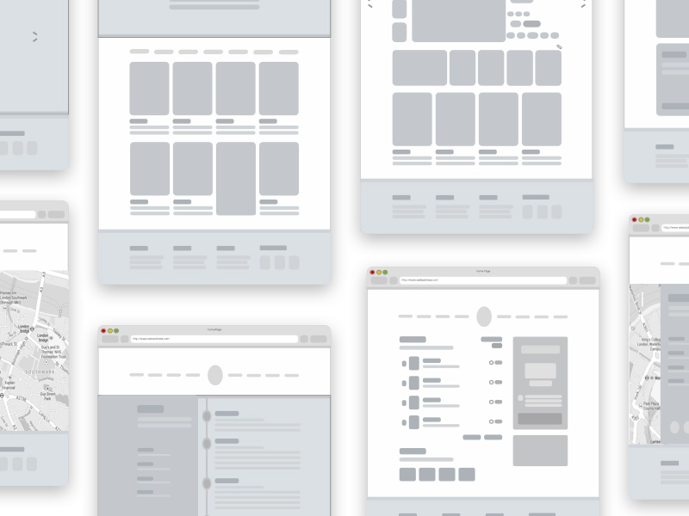
E - COMMERCE WEBSITE Using Django

Slide 2
AGENDA
Introduction
Technologies Used
Activity & Use-case Description
Task Status & Project Timeline

Slide 3
Introduction
This Web Development project deals with developing an E-commerce Website. It provides the user with a list of the different products available for purchase in the online store. A shopping cart is provided. After the products are selected, it is sent for the order confirmation. The system is implemented using Python’s web framework Django and SQLite Database which comes with the framework.
The website will display products, customers can browse the catalog and select products, customer can remove products from their cart specifying the quantity of each item. Selected items will be stored in a cart. At checkout, the items in the cart will be presented as an order. Customers can pay for the items in the cart through a payment portal to complete the order. The project also provides security with the use of login ID and passwords, so that no unauthorized users can access your account. Only authorized person with access authority can access the software.

Slide 4
Technologies Used
Python
JavaScript
React
Django Framework
Notes:
Payment Integration will be handled by PayPal or Stripe.

Slide 5
Django Framework
Django is a high-level python web framework that encourages rapid development and clean, pragmatic design. built by experienced developers, It takes care of much of the hassle of web development, so you can focus on writing your app without needing to reinvent the wheel.
It’s free and open source.
Fast
Django was designed to help developers take applications from concept to completion as quickly as possible.
Secure
Django takes security seriously and helps developers avoid many common security mistakes.
Scalable
Django helps in scaling the website based on user traffic.
Notes:
Additionally, Django provides a dynamic CRUD interface, configured with admi models and generated via introspection.

Slide 6
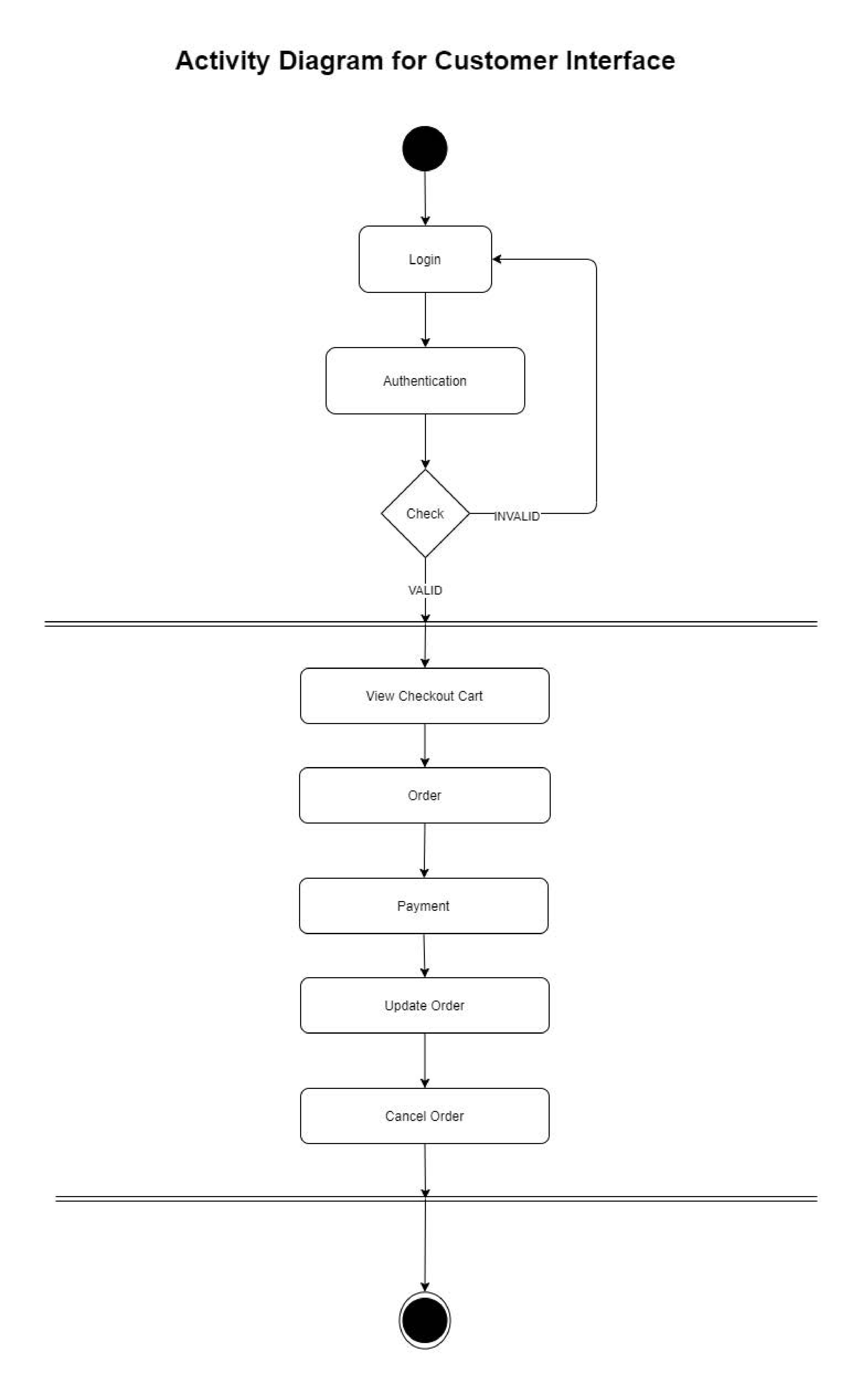

Slide 7
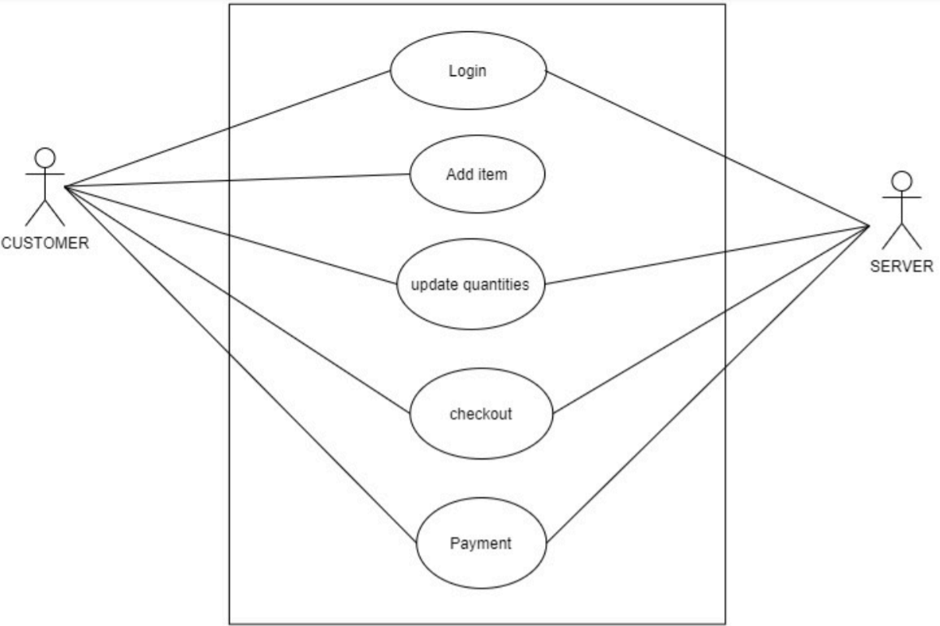
Use-case Diagram

Slide 8
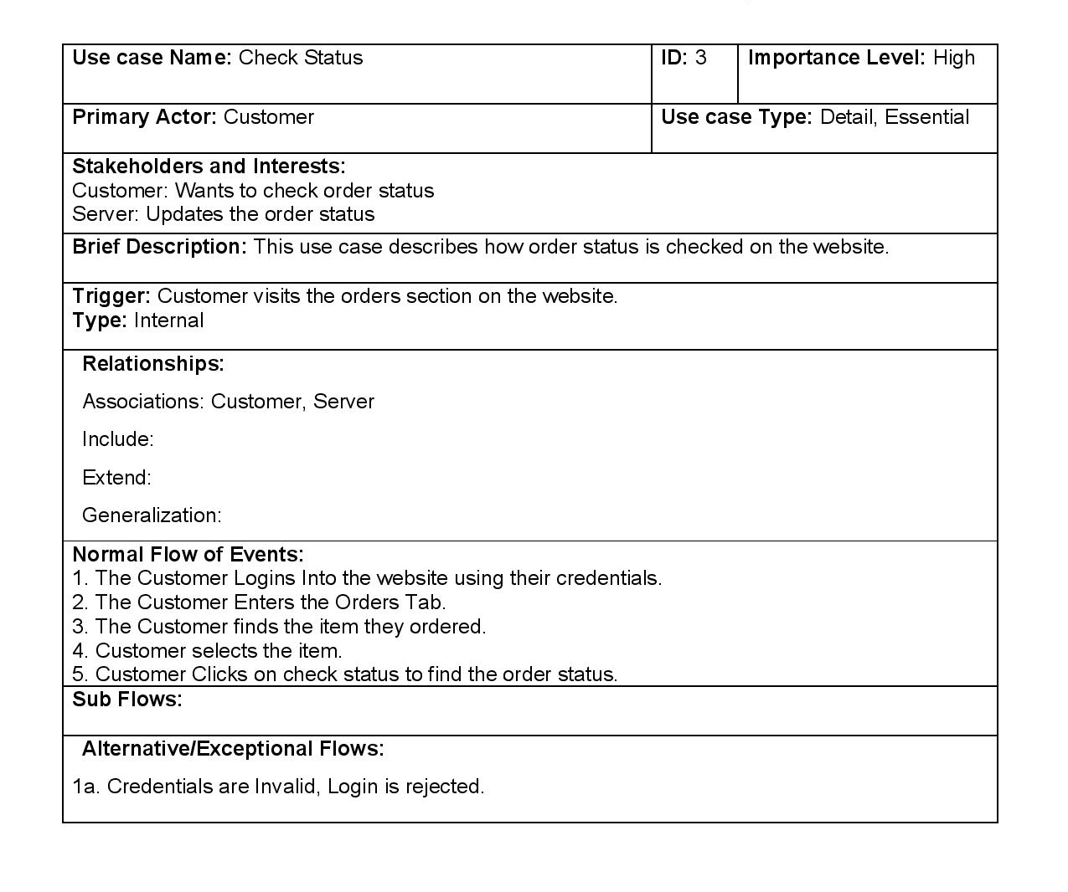
USE CASE DESCRIPTION
Notes:
Project focuses on 3 main templates : STORE , CART, CHECKOUT

Slide 9
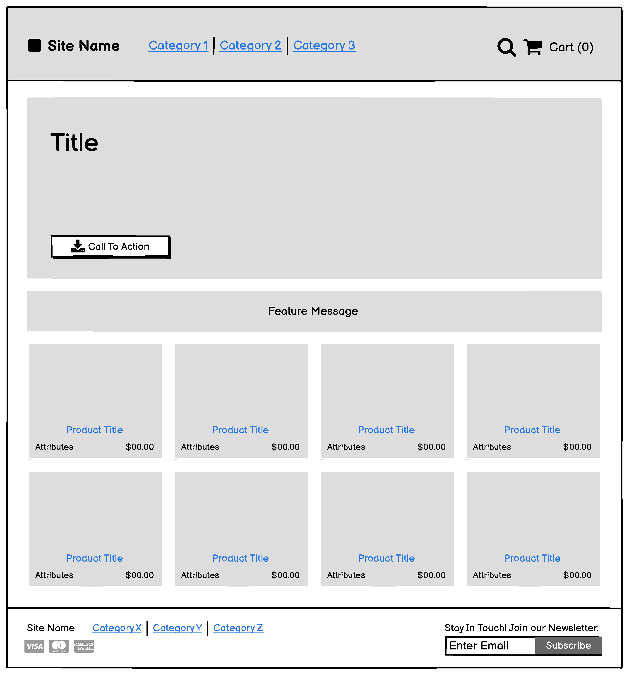
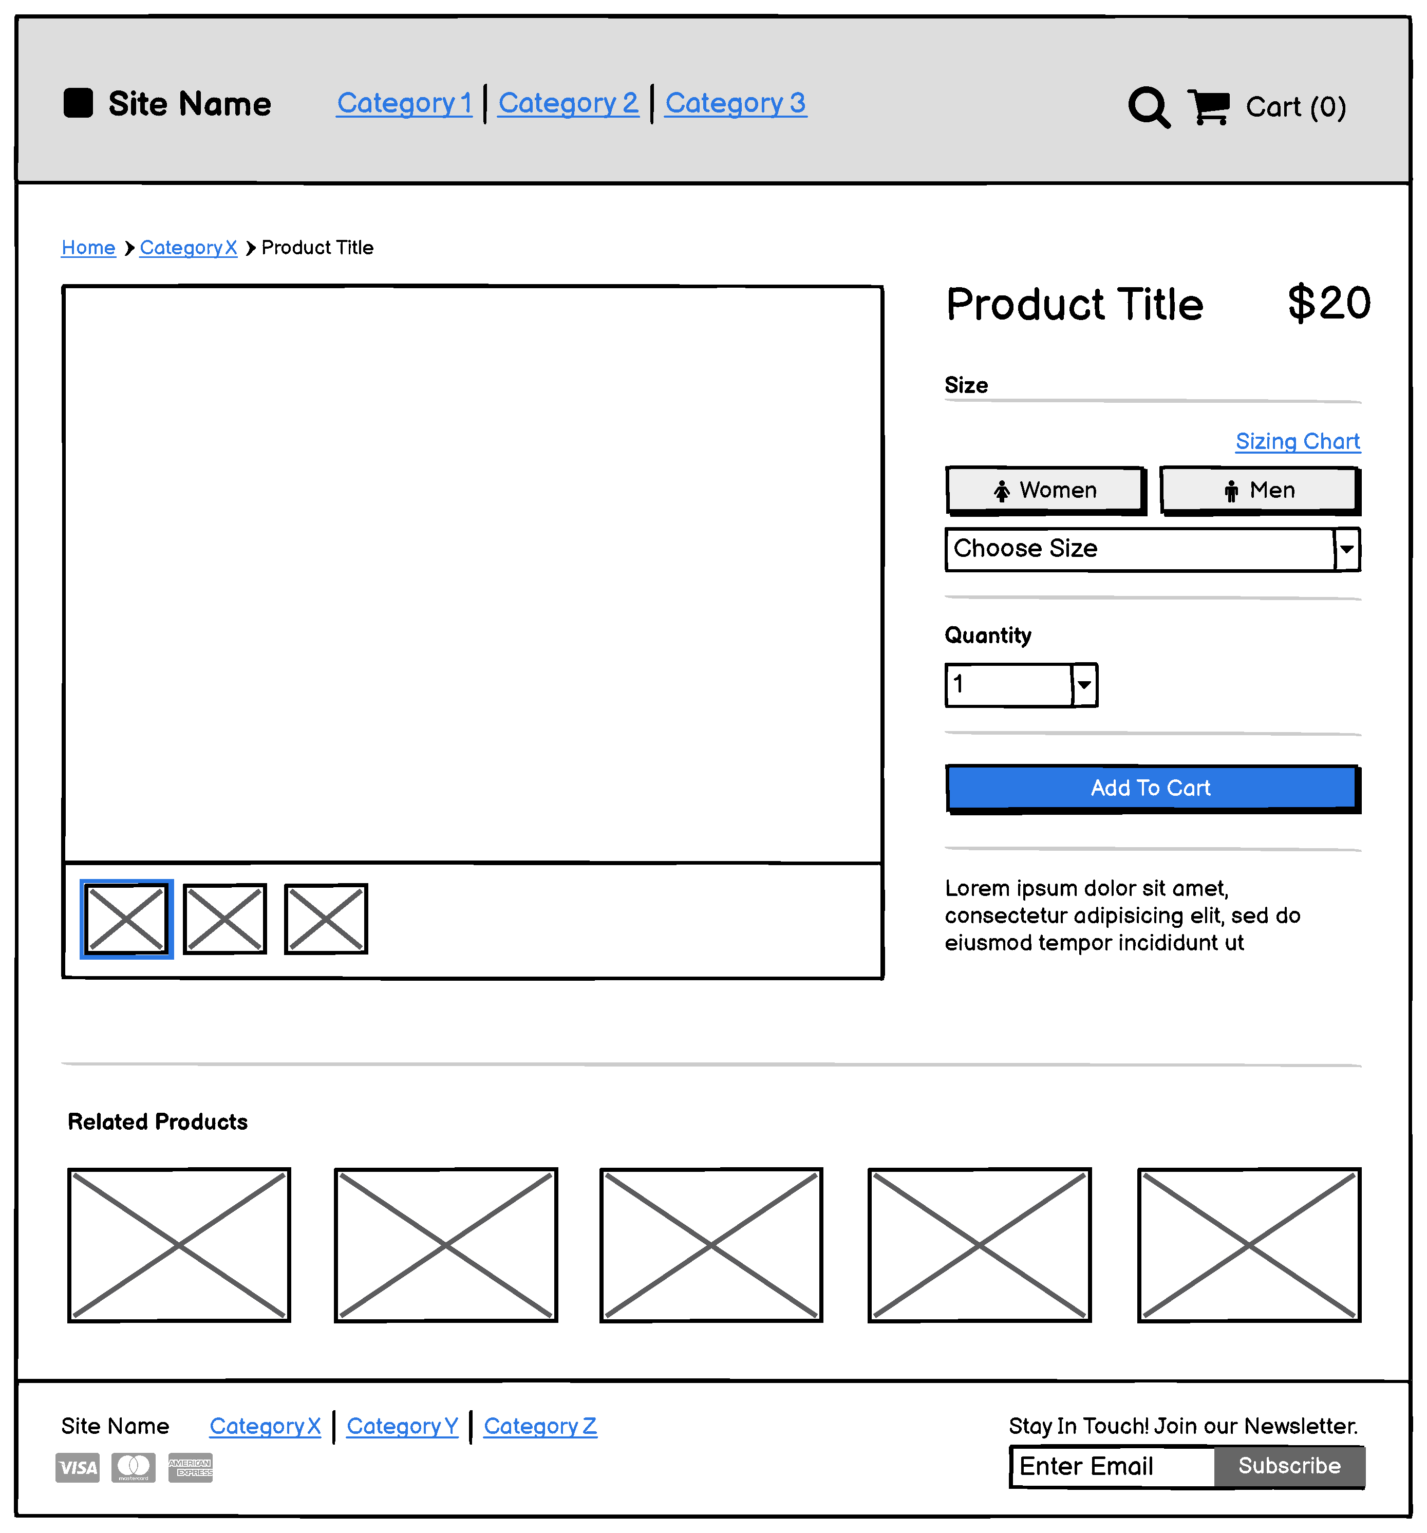
Wireframes

Slide 10
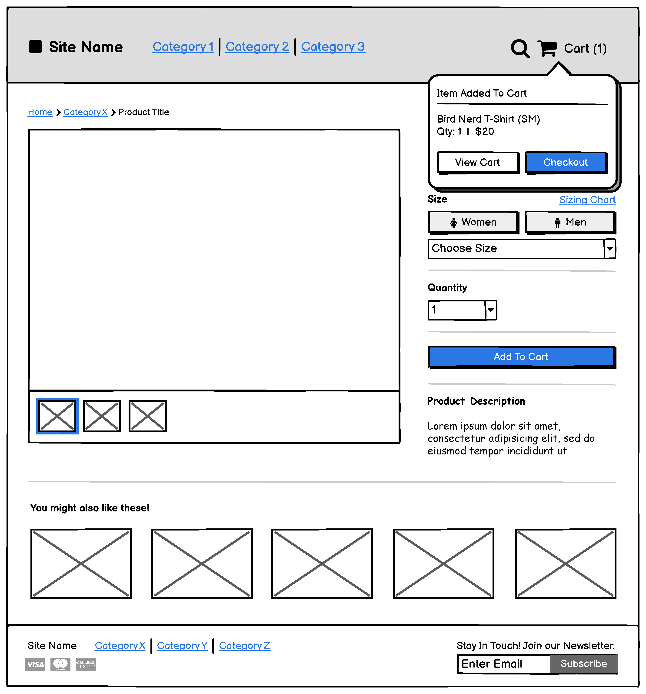
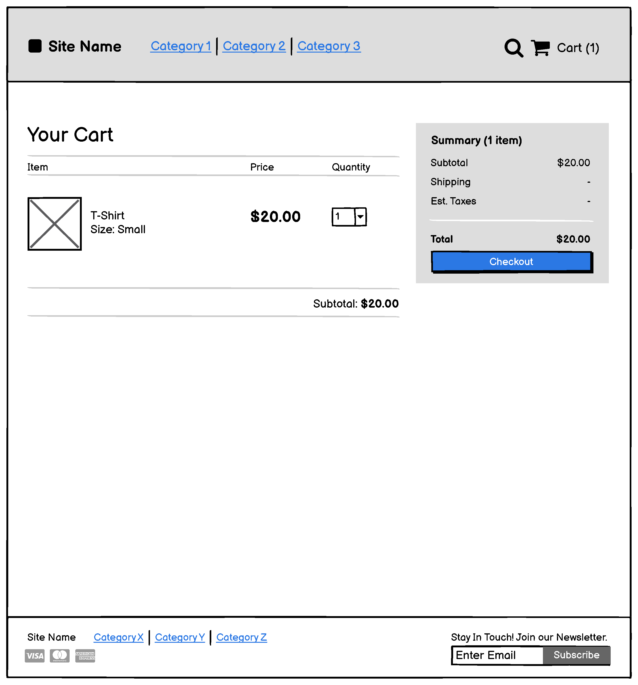

Slide 11
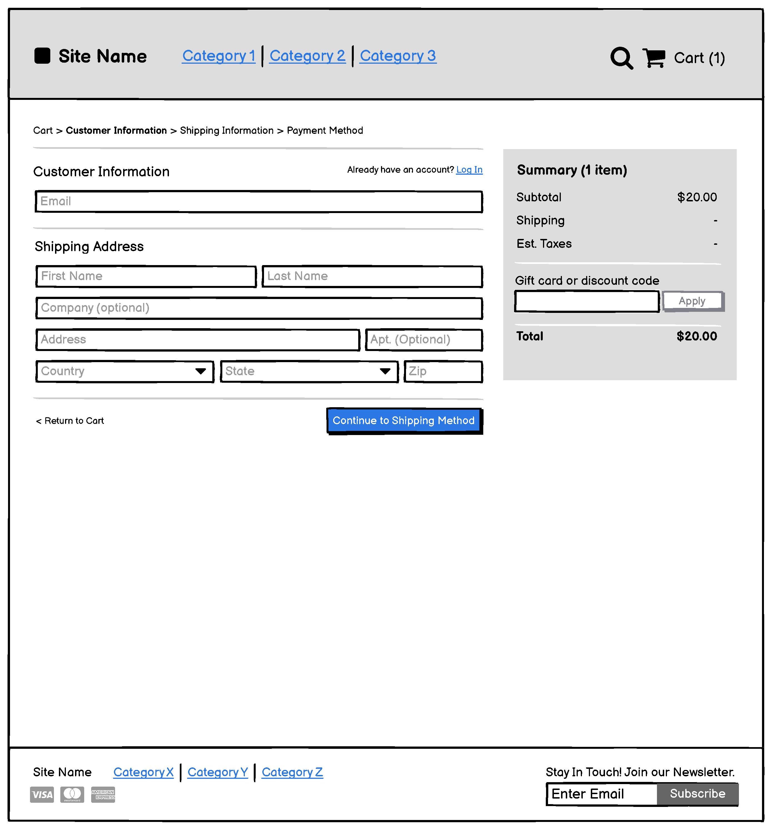
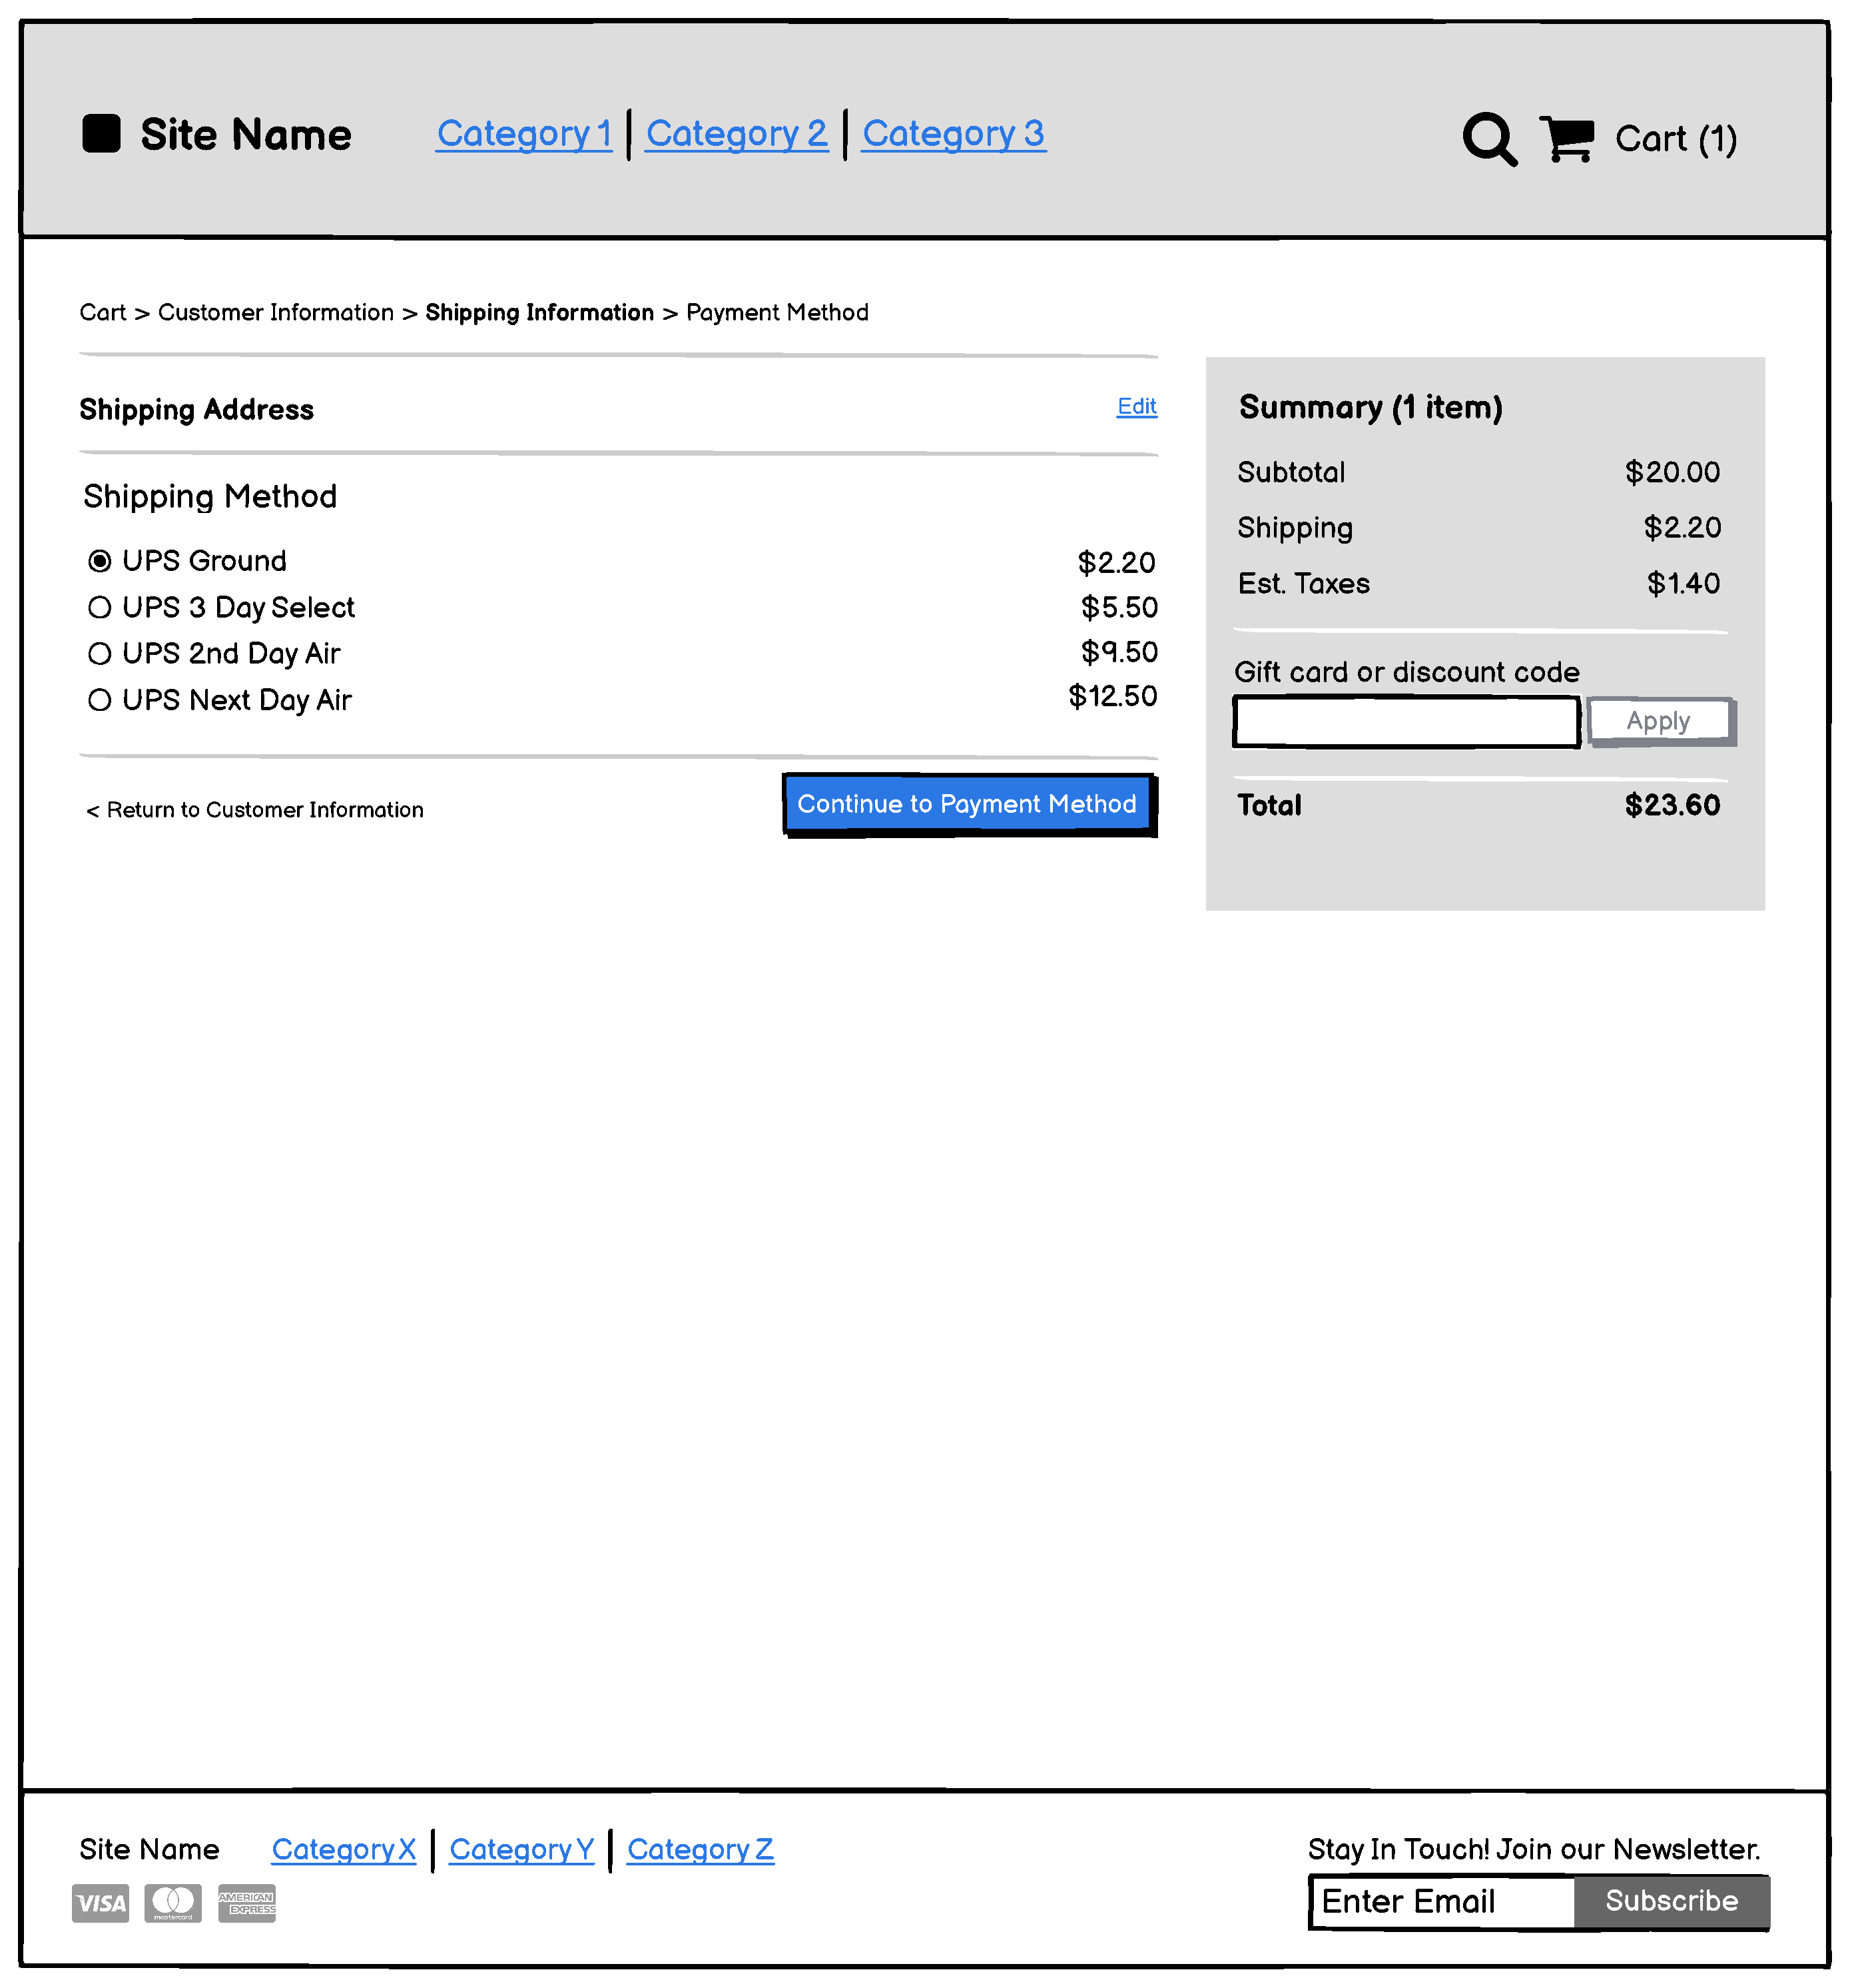

Slide 12
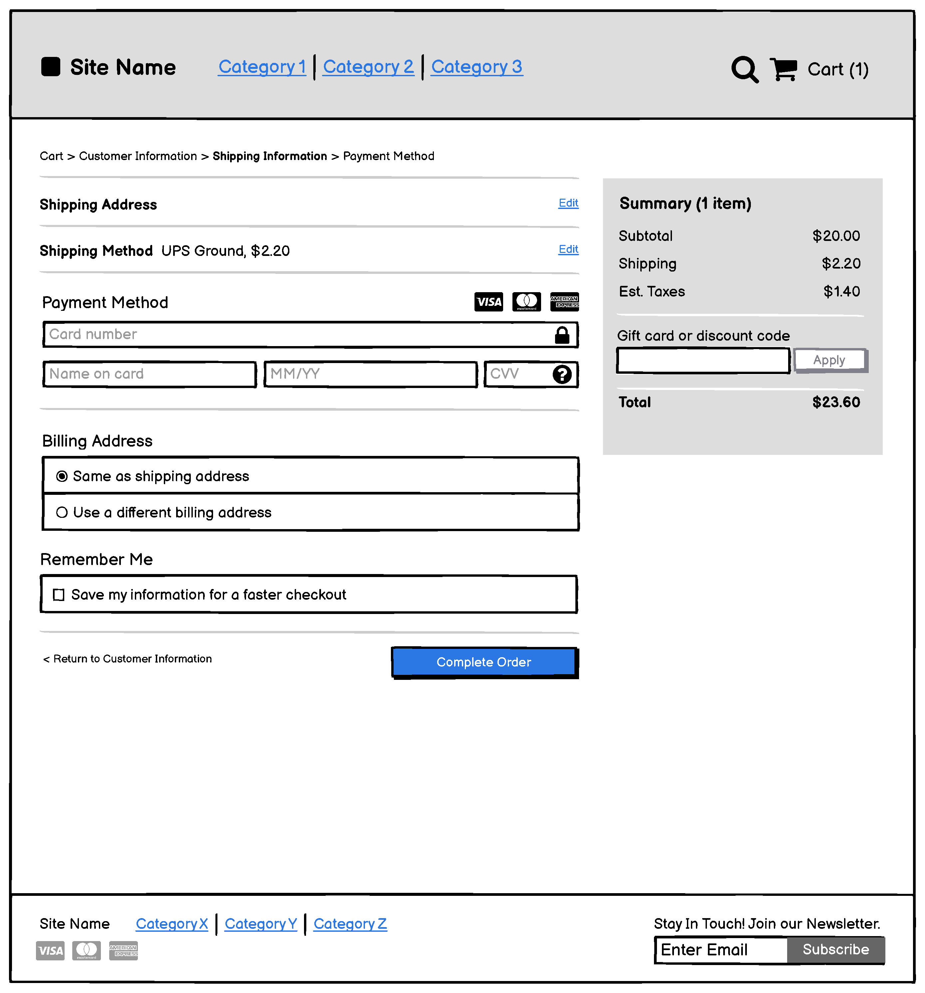
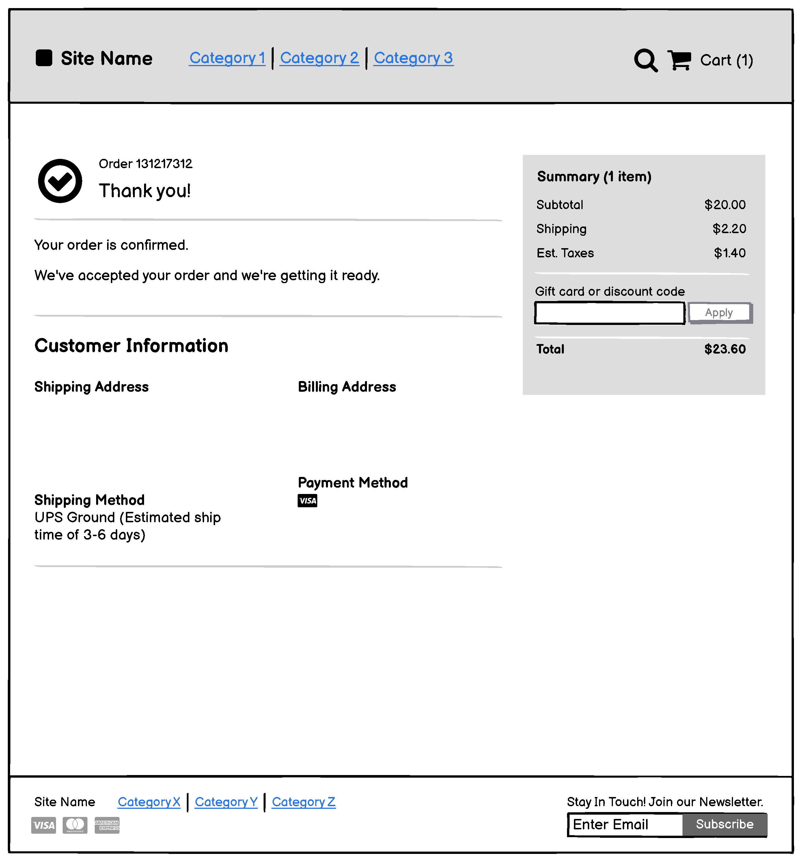

Slide 13
 | PROJECT TIMELINE
 | ECOMMERCE WEBSITE
 | ACTIVITY | START DATE | END DATE | ALLOCATED TO | PERCENT COMPLETE | REMAINING PERCENT | PERIODS | Sep 20, 2021 |  |  |  |  |  |  | Sep 27, 2021 |  |  |  |  |  |  | Oct 4, 2021 |  |  |  |  |  |  | Oct 11, 2021 |  |  |  |  |  |  | Oct 18, 2021 |  |  |  |  |  |  | Oct 25, 2021 |  |  |  |  |  |  | Nov 1, 2021 |  |  |  |  |  |  | Nov 8, 2021
 |  |  |  |  |  |  | 1 | 20 | 21 | 22 | 23 | 24 | 25 | 26 | 27 | 28 | 29 | 30 | 1 | 2 | 3 | 4 | 5 | 6 | 7 | 8 | 9 | 10 | 11 | 12 | 13 | 14 | 15 | 16 | 17 | 18 | 19 | 20 | 21 | 22 | 23 | 24 | 25 | 26 | 27 | 28 | 29 | 30 | 31 | 1 | 2 | 3 | 4 | 5 | 6 | 7 | 8 | 9 | 10 | 11 | 12 | 13 | 14 | 58 | 59 | 60
 | Collecting Information | 9-23-21 | 30-09-21 | Everyone | 56% | 10% |  | M | T | W | T |  |  |  |  |  |  |  | S | S | M | T | W | T | F | S | S | M | T | W | T | F | S | S | M | T | W | T | F | S | S | M | T | W | T | F | S | S | M | T | W | T | F | S | S | M | T | W | T | F | S | S
 | Evaluating and Analyzing Information | 28-Sep | 03-Oct | Everyone | 95% | 5%
 | Proper Documnetation information | 01-10-21 | 06-10-21 | Everyone | 75% | 25%
 | ACTIVTY DIAGRAM,USE CASE & CLASS DIAGRAM
 | Use Case Design Diagram | 29-09-21 | 02-10-21 | Vamshi | 100% | 0%
 | Activity Diagram | 29-09-21 | 02-10-21 | Hitesh | 100% | 0%
 | Class Diagram | 06-10-21 | 09-10-21 | Rithwik | 100% | 0%
 | CRC | 06-10-21 | 08-10-21 | Charan | 100% | 0%
 | Sequence Diagram and State Machine | 13-10-21 | 15-10-21 | Vamshi & Charan | 100%
 | RESPOSIBILITY & IMPLEMENTATION
 | Designing Page layout | 24-10-21 | 03-11-21 | Rithwik | 0% | 0%
 | Building code for Shopcart | 03-11-21 | 07-11-21 | Vamshi | 0% | 0%
 | Planning | 07-11-21 | 20-11-21 | Charan & Hitesh | 0% | 0%
 | Product Catalouge | 12-11-21 | 18-11-21 | Hitesh | 0% | 0%
 | Payment Processing | 14-11-21 | 20-11-21 | Vamshi & Rithwik | 0% | 0%
 | TESTING
 | Debugging Code | 10-11-21 | 24-11-21 | Vamshi | 0% | 0%
 | Testing Shopping Cart | 24-11-21 | 03-12-21 | Hitesh | 0% | 0%
 | Searching for the Product | 03-12-21 | 07-12-21 | Charan | 0% | 0%
 | Re Designing and testing Webpages | 01-12-21 | 17-12-21 | Rithwik | 44% | 0%
 | DEPLOYMENT
 | Activity 01 | 29-09-21 | 02-10-21 |  | 50%
 | Activity 02 | 29-09-21 | 02-10-21 |  | 40%
 | Activity 03 | 06-10-21 | 09-10-21 |  | 60%
 | Activity 04 | 06-10-21 | 08-10-21 |  | 20%

Slide 14
Tasks completed
Established environment
Created Admin Login
To be done
Getting the Database up and running - October 4th week
Front-end Designing - begins from November 1st Week
Initial Debugging - November 1st week
Polishing the UI - November 2nd week

Slide 15
Thank you
TEAM ALPHA
•VAMSHI KRISHNA REDDY
•GURUCHARAN PARSA
•HITESH GONE
•RITHWIK SAGAR KONDALA

